Slide 1
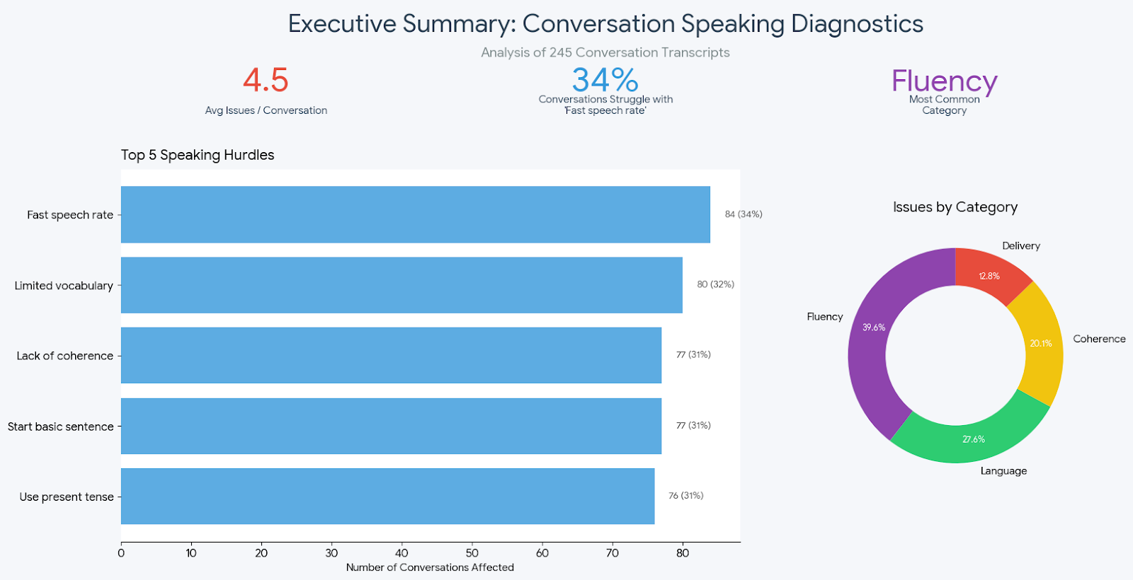
How speakers perform?

Slide 2
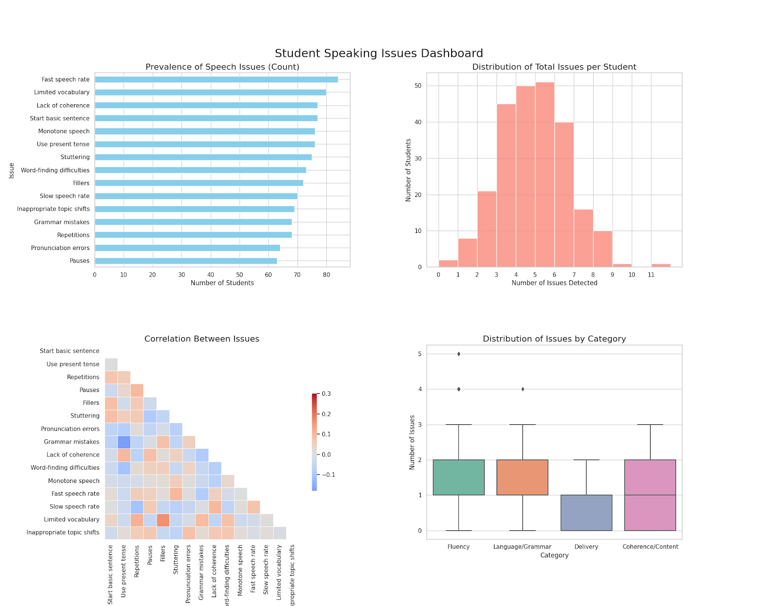
Distribution of areas to improve

